Slide 1
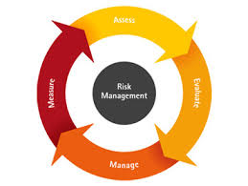
Module – IV : Risk and Configuration Management
Software Engineering (SE) → CSEN 3202 – CSE/Btech/6th Semester → Module-IV → Prepared by : Nilina Bera, CSE, HITK

Slide 2
Risk Management
Risk is an expectation of loss, a potential problem that may or may not occur in the future.
It is generally caused due to lack of information, control or time
A possibility of suffering from loss in software development process is called a software risk.
Nilina Bera

Slide 3
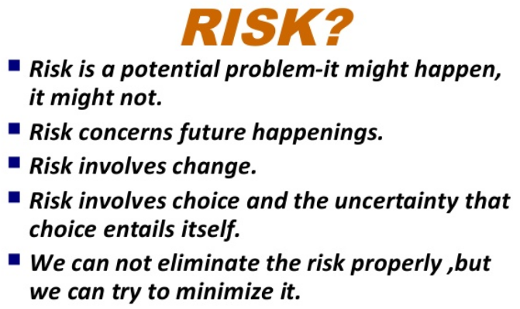
Nilina Bera

Slide 4
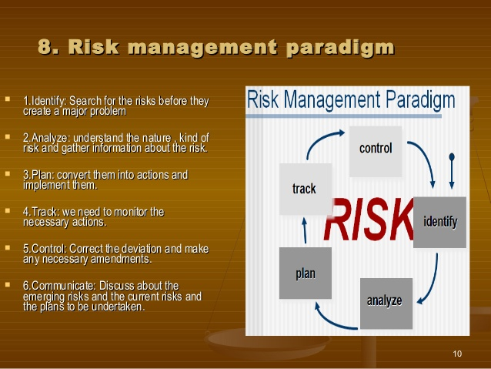
Nilina Bera

Slide 5
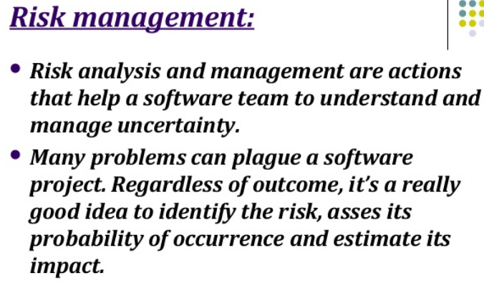
Nilina Bera

Slide 6
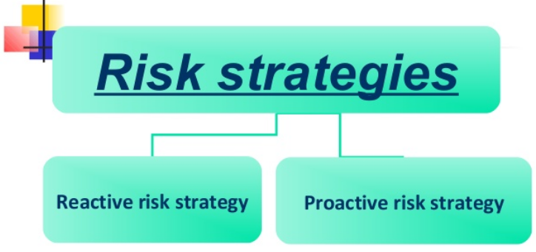
Nilina Bera

Slide 7
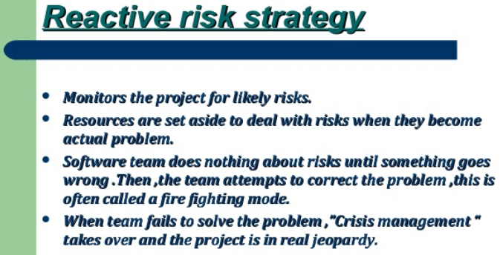
Nilina Bera

Slide 8
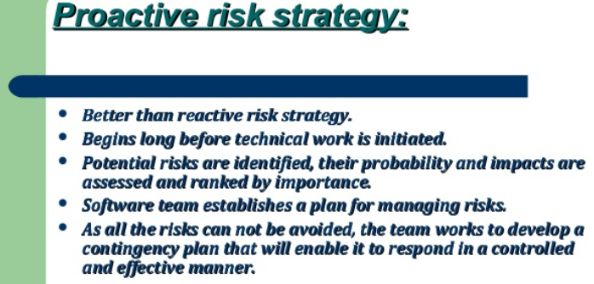
Nilina Bera

Slide 9
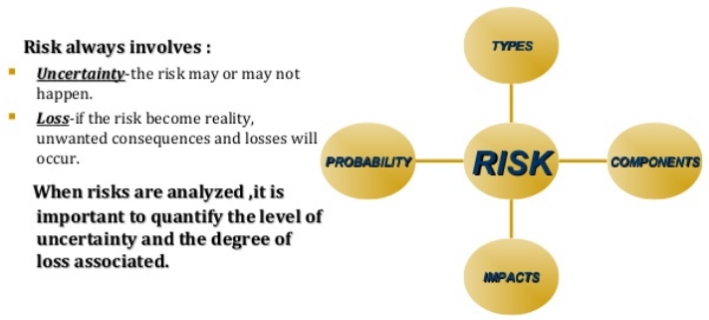
Nilina Bera

Slide 10
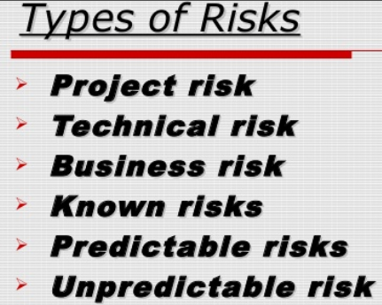
Nilina Bera

Slide 11
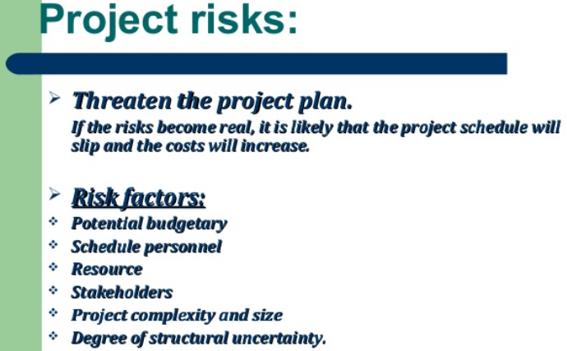
Nilina Bera

Slide 12
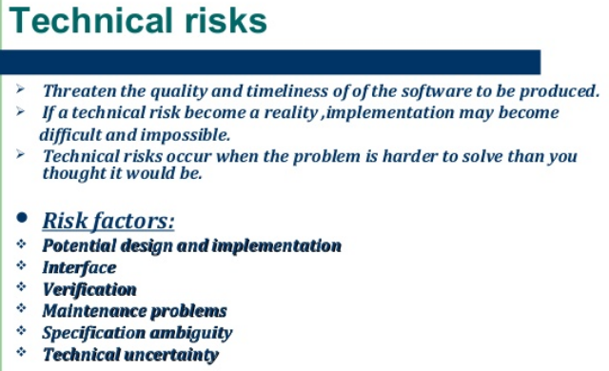
Nilina Bera

Slide 13
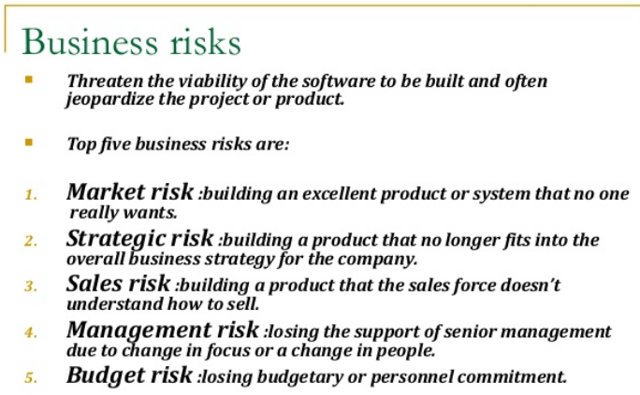
Nilina Bera

Slide 14
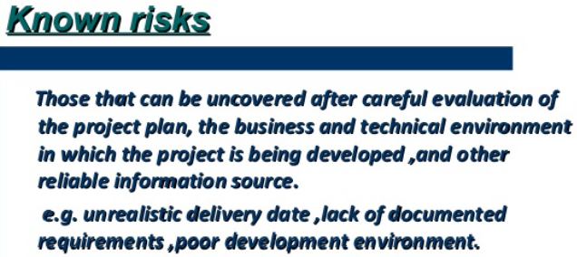
Nilina Bera

Slide 15
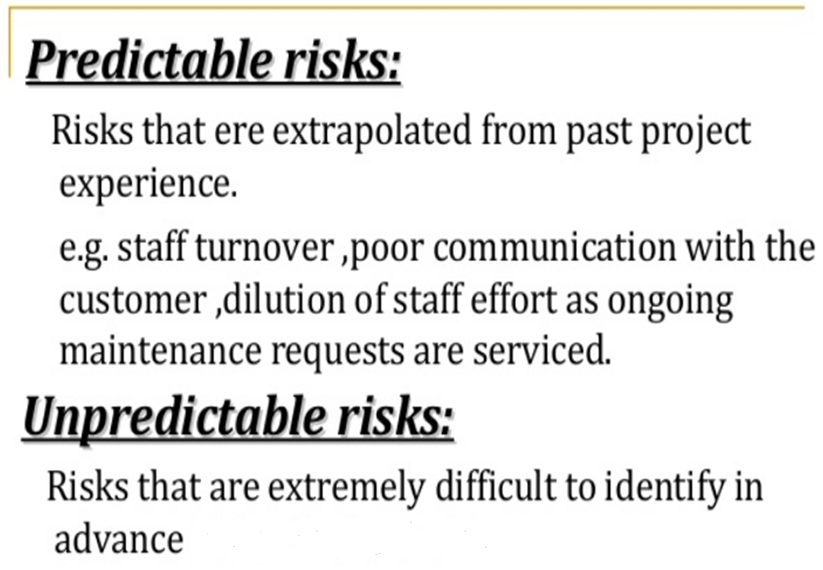
Nilina Bera

Slide 16
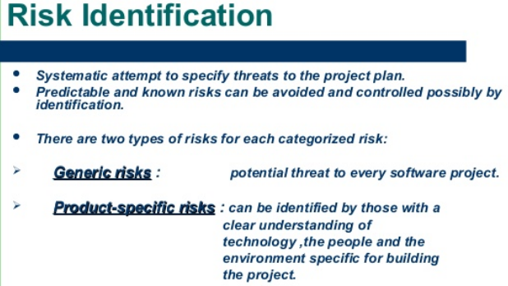
Nilina Bera

Slide 17
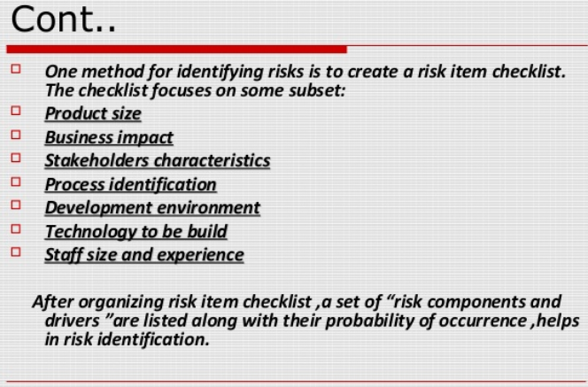
Nilina Bera

Slide 18
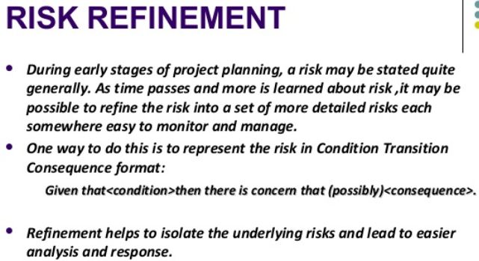
Nilina Bera

Slide 19
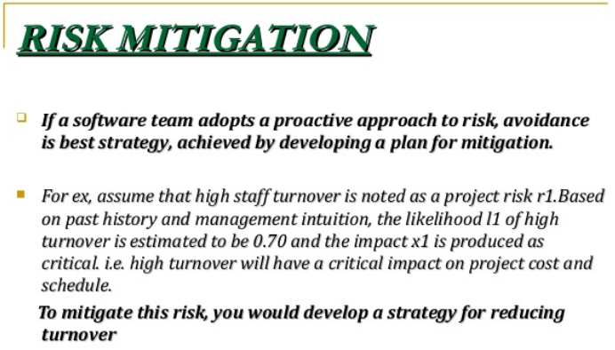
Nilina Bera

Slide 20
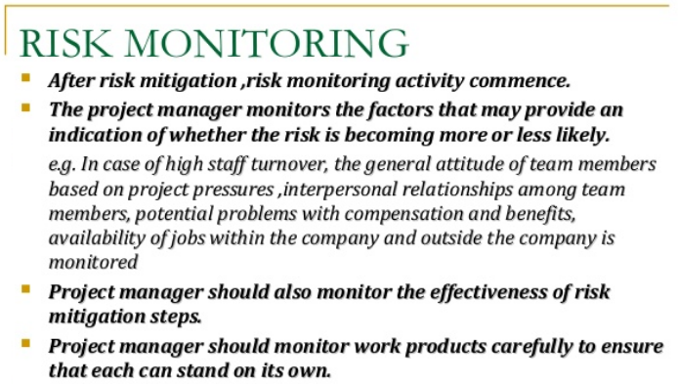
Nilina Bera

Slide 21
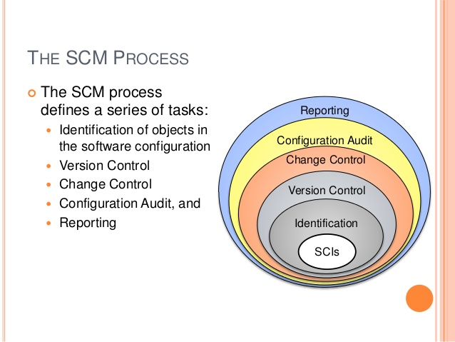
Software Configuration Management (SCM)
Nilina Bera

Slide 22
Software configuration management
The results (also called as the deliverables) of a large software development effort typically consist of a large number of objects, e.g. source code, design document, SRS document, test document, user’s manual, etc.
These objects are usually referred to and modified by a number of software engineers through out the life cycle of the software.
The state of all these objects at any point of time is called the configuration of the software product.
The state of each deliverable object changes as development progresses and also as bugs are detected and fixed.
Nilina Bera

Slide 23
Software Configuration Item
A configuration item (CI) is an item or aggregation of hardware or software or both that is designed to be managed as a single entity.
A software configuration item (SCI) is a software entity that has been established as a configuration item.
The SCM typically controls a variety of items in addition to the code itself.
Software items with potential to become SCIs include plans, specifications and design documentation, testing materials, software tools, source and executable code, code libraries, data and data dictionaries, and documentation for installation, maintenance, operations, and software use.
Selecting SCIs is an important process in which a balance must be achieved between providing adequate visibility for project control purposes and providing a manageable number of controlled items.
Nilina Bera

Slide 24
Four component of a good Configuration Management System
1. Configuration Identification - It is the process of identification of Configuration Items (CI) and developing a method to uniquely identify each individual CI. It helps answers the following questions:
Which items are placed under configuration management?
What are the components of the product?
What is the structure (or configuration) of components in the product?
What are the versions of the configuration items?
2. Configuration Control - It is the activity of managing the product (or project's deliverables) and related documentation, throughout the lifecycle of the product. It answers the questions:
Which items are controlled?
How are changes controlled?
Who controls the changes?
Nilina Bera

Slide 25
Four component of a good Configuration Management System
3. Configuration Status Accounting - It involves the recording and reporting of all the changes to the configuration items. It tells us:
What is the status of proposed changes?
What changes have been made?
When were the changes made?
What components were affected by the change?
4. Configuration verification and audit - It is the process of verifying the correctness of the product and its components in order to ensure conformance to requirements. It also means verifying the correctness of the Configuration Status Accounting information. It helps to:
Ensure that all the configuration items have been correctly identified and accounted for.
Ensure that all the changes have been registered, assessed, approved, tracked, and correctly implemented.
Measure the effectiveness of the configuration management process.
Nilina Bera

Slide 26
Release vs. Version vs. Revision
A new version of a software is created when there is a significant change in functionality, technology, or the hardware it runs on, etc.
On the other hand a new revision of a software refers to minor bug fix in that software.
A new release is created if there is only a bug fix, minor enhancements to the functionality, usability, etc.
For example, one version of a mathematical computation package might run on Unix-based machines, another on Microsoft Windows and so on.
As a software is released and used by the customer, errors are discovered that need correction.
Enhancements to the functionalities of the software may also be needed.
A new release of software is an improved system intended to replace an old one.
Often systems are described as version m, release n; or simple m.n.
Formally, a history relation is version of can be defined between objects.
This relation can be split into two sub relations is revision of and is variant of.
Nilina Bera

Slide 27
Necessity of software configuration management
There are several reasons for putting an object under configuration management.
But, possibly the most important reason for configuration management is to control the access to the different deliverable objects.
Unless strict discipline is enforced regarding updating and storage of different objects, several problems appear.
The following are some of the important problems that appear if configuration management is not used.
Nilina Bera

Slide 28
Necessity of software configuration management
Inconsistency problem when the objects are replicated.
A scenario can be considered where every software engineer has a personal copy of an object (e.g. source code).
As each engineer makes changes to his local copy, he is expected to intimate them to other engineers, so that the changes in interfaces are uniformly changed across all modules.
However, many times an engineer makes changes to the interfaces in his local copies and forgets to intimate other teammates about the changes.
This makes the different copies of the object inconsistent.
Finally, when the product is integrated, it does not work.
Therefore, when several team members work on developing an object, it is necessary for them to work on a single copy of the object, otherwise inconsistency may arise.
Nilina Bera

Slide 29
Necessity of software configuration management
Problems associated with concurrent access.
Suppose there is a single copy of a problem module, and several engineers are working on it.
Two engineers may simultaneously carry out changes to different portions of the same module, and while saving overwrite each other.
Though the problem associated with concurrent access to program code has been explained, similar problems occur for any other deliverable object.
Nilina Bera

Slide 30
Necessity of software configuration management
Providing a stable development environment.
When a project is underway, the team members need a stable environment to make progress.
Suppose somebody is trying to integrate module A, with the modules B and C, he cannot make progress if developer of module C keeps changing C; this can be especially frustrating if a change to module C forces him to recompile A.
When an effective configuration management is in place, the manager freezes the objects to form a base line.
When anyone needs any of the objects under configuration control, he is provided with a copy of the base line item.
The requester makes changes to his private copy.
Only after the requester is through with all modifications to his private copy, the configuration is updated and a new base line gets formed instantly.
This establishes a baseline for others to use and depend on.
Also, configuration may be frozen periodically.
Freezing a configuration may involve archiving everything needed to rebuild it.
Nilina Bera

Slide 31
Necessity of software configuration management
System accounting and maintaining status information.
System accounting keeps track of who made a particular change and when the change was made.
Handling variants.
Existence of variants of a software product causes some peculiar problems.
Suppose somebody has several variants of the same module, and finds a bug in one of them.
Then, it has to be fixed in all versions and revisions.
To do it efficiently, he should not have to fix it in each and every version and revision of the software separately.
Nilina Bera

Slide 32
Software configuration management activities
Normally, a project manager performs the configuration management activity by using an automated configuration management tool.
A configuration management tool provides automated support for overcoming all the problems mentioned above.
In addition, a configuration management tool helps to keep track of various deliverable objects, so that the project manager can quickly and unambiguously determine the current state of the project.
The configuration management tool enables the engineers to change the various components in a controlled manner.
Nilina Bera

Slide 33
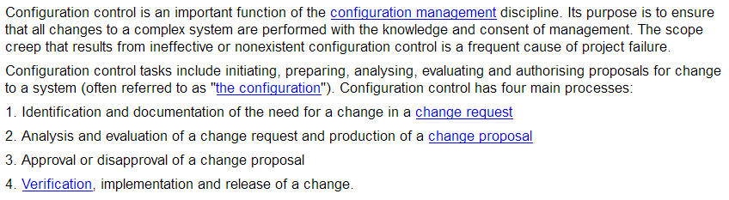
Configuration control
(Aliases: change control, change management)
It is not the strongest of the species that survive, nor the most intelligent, but the ones most responsive to change. Charles Darwin
Nilina Bera

Slide 34
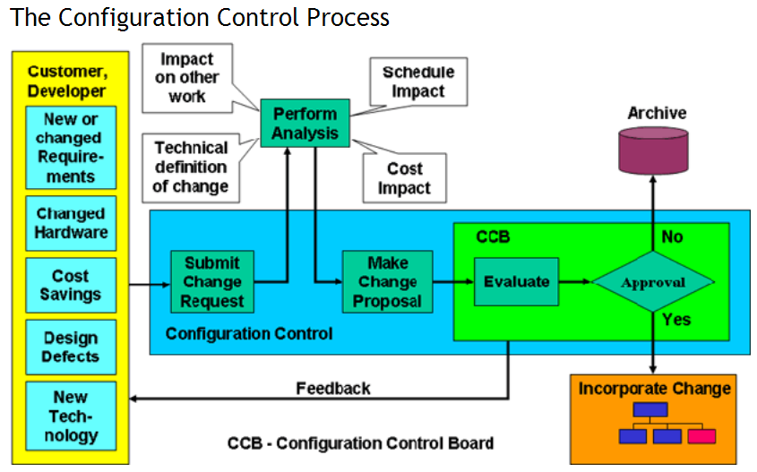
Nilina Bera

Slide 35
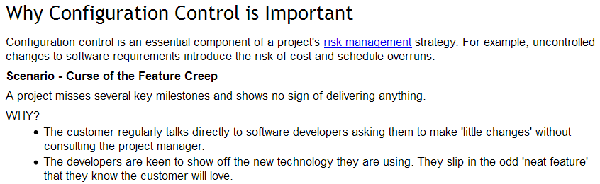
Nilina Bera

Slide 36
7 Configuration Management (CM) Tools You Need to Know About
https://www.upguard.com/articles/the-7-configuration-management-tools-you-need-to-know
Nilina Bera

